Slide 1
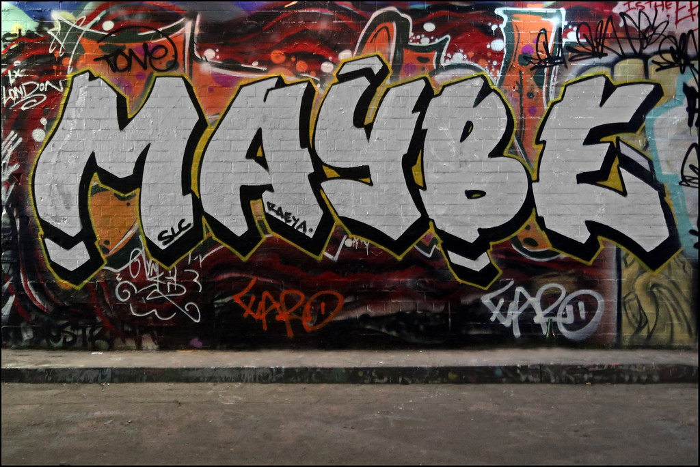
VS MODE
OPtIONS
online
credits
Background by Alex Ellison

Slide 2
VS MODE
OPtIONS
online
credits
Background by Alex Ellison

Slide 3
VS MODE
OPtIONS
online
credits
Background by Alex Ellison

Slide 4
VS MODE
OPtIONS
online
credits
Background by Alex Ellison

Slide 5
VS MODE
OPtIONS
online
credits
Background by Alex Ellison

Slide 6
credits
The programing & graphics of the game are all done by me dani sachwani
you can contact me by email
danisachwani@gmail.com
Back

Slide 7
credits
The programing & graphics of the game are all done by me dani sachwani
you can contact me by email
danisachwani@gmail.com
Back

Slide 8
Select Your figHTer
Back

Slide 9
Select Your figHTer
Back

